Slide 1
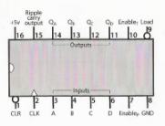
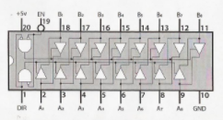
Ben Eater’s 8 Bit Computer
PROGRAM COUNTER IC PINOUTS
74LS245:
8-bit bus transceiver
74LS161:
4-bit binary counter

